Slide 1
Property Inspection Demo
Preparation and Walkthrough

Slide 2
Preparing The Data
The following slides illustrates the data that should be in the system when the demo is started. The Property Management My App provisions this data.
As you will see, some of the lists are read only and you will never have to delete data in them to reset the demo.
Lists that do not indicate they are read only should be trimmed of extra data to reset the demo.

Slide 3
Preparing Calendars
Log into OWA with Ron Gabel and delete all calendar invites for the day after the demo. For example, if you are doing the demo on the October 28 then delete all entries on the October 29.

Slide 4
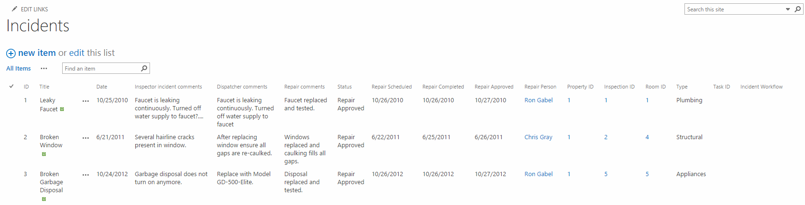
Incidents List The Property Management My App provisions the data in this list. Make sure your list matches the data pictured below.

Slide 5
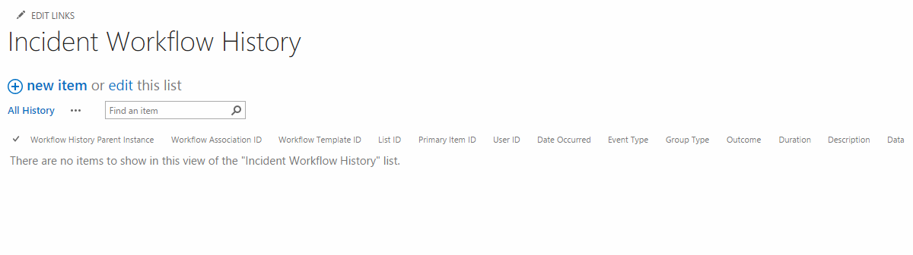
Incident Workflow History List This list is empty to start.

Slide 6
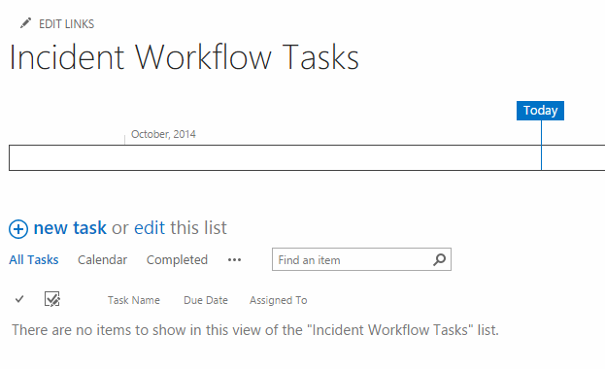
Incident Workflow Tasks List This list is empty to start.

Slide 7
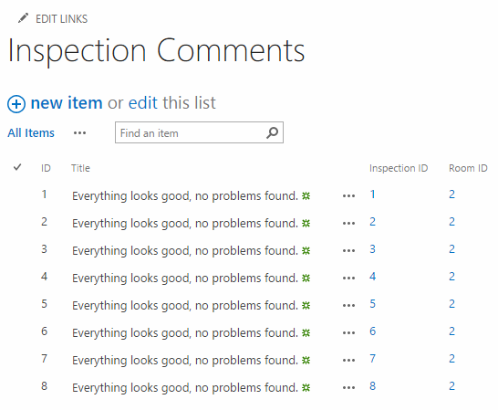
Inspection Comments The Property Management My App provisions the data in this list. Make sure your list matches the data pictured below.

Slide 8
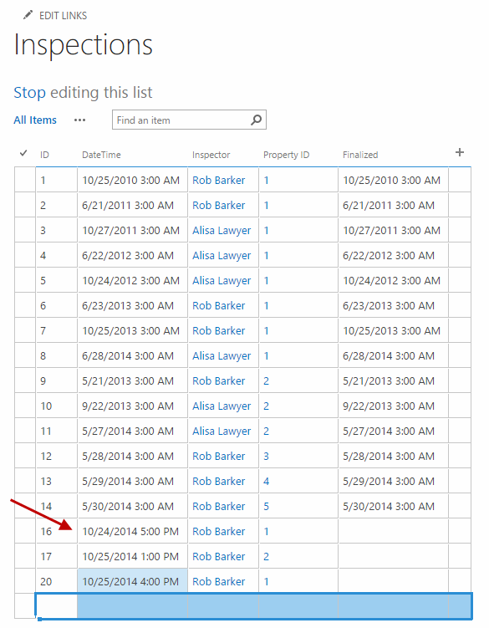
Inspections List The Property Management My App provisions the data in this list. Make sure your list matches the data pictured below and create the list items described below. This is this list you seed with an Inspection before you do the demo. The arrow below indicates the inspection that will be used in the demo. This Inspection (16), and the two below it in the list (17 and 20) are ones I manually added to support the demo. You will add the same ones and adjust the dates accordingly. The date for the inspection used in the demo should be the same as the day you do the demo. The time for this inspection should be after the demo will occur. For example, if your demo is on October 24 at 10AM then setting 10/24/2014 and 1PM is the correct way to set up the inspection you use in the demo. You must select Rob Barker for the inspector and Property Id 1. The two inspections at the end of the list are added to populate data in the upcoming inspections category in the apps used in the demo.

Slide 9
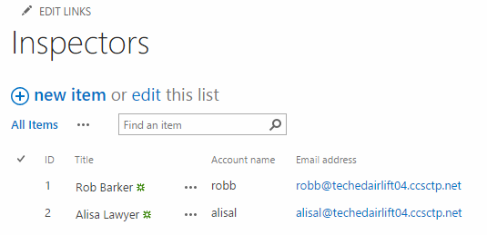
Inspectors List The Property Management My App provisions the data in this list. Make sure your list matches the data pictured below. This list is read only so you should never modify it or have to clean it out.

Slide 10
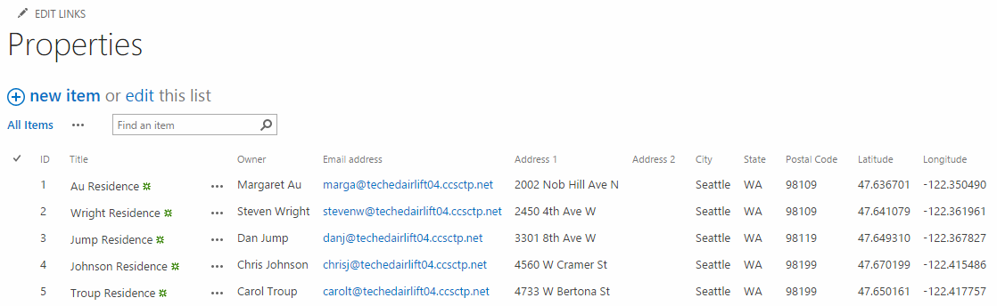
Properties List The Property Management My App provisions the data in this list. Make sure your list matches the data pictured below. This list is read only so you should never modify it or have to clean it out.

Slide 11
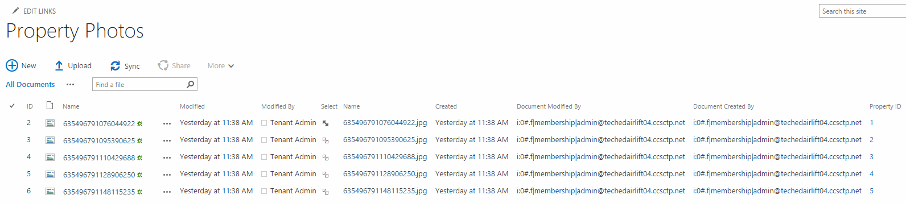
Property Photos The Property Management My App provisions the data in this list. Make sure your list matches the data pictured below. The Name values will differ in your tenancy.

Slide 12
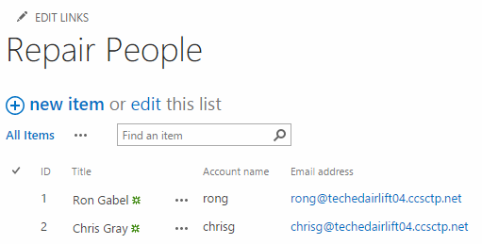
Repair People The Property Management My App provisions the data in this list. Make sure your list matches the data pictured below. This list is read only so you should never modify it or have to clean it out. The Email address domain will match your tenancy.

Slide 13
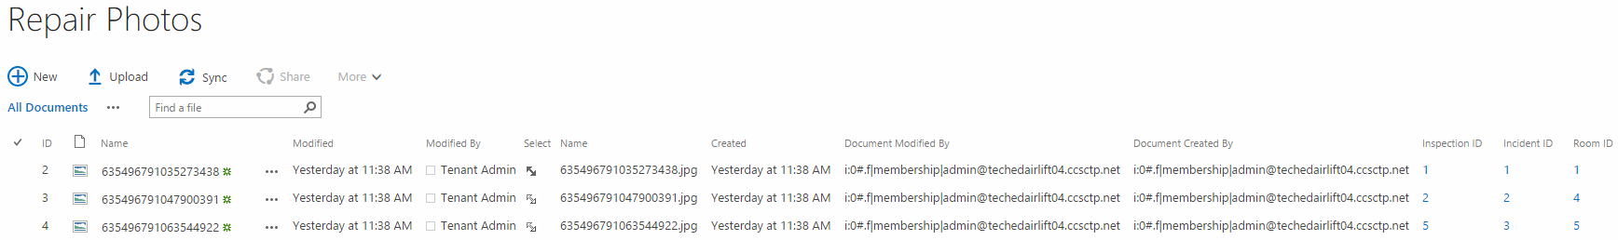
Repair Photos The Property Management My App provisions the data in this list. Make sure your list matches the data pictured below. The Name values will differ in your tenancy.

Slide 14
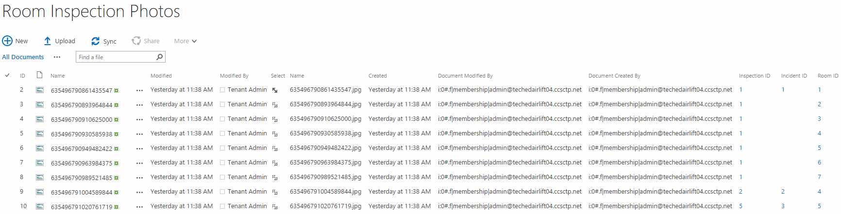
Room Inspection Photos The Property Management My App provisions the data in this list. Make sure your list matches the data pictured below. The Name values will differ in your tenancy.

Slide 15

Rooms List. The Property Management My App provisions the data in this list. The Rooms list has 35 entries. This list is read only so you should never modify it or have to clean it out.

Slide 16
Walkthrough
These following slides describe how to execute the demo, the lists items that are modified during each step, and the emails which are sent.

Slide 17
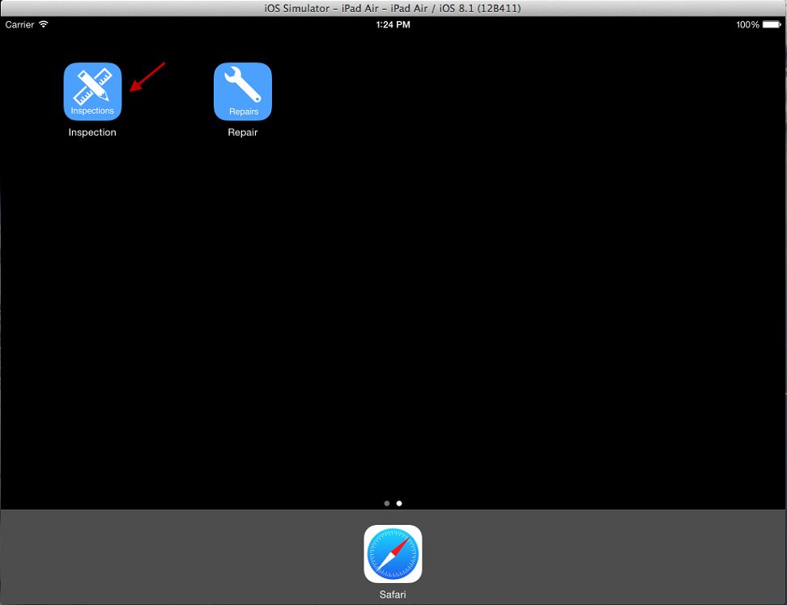
Open Inspection App On iPad

Slide 18
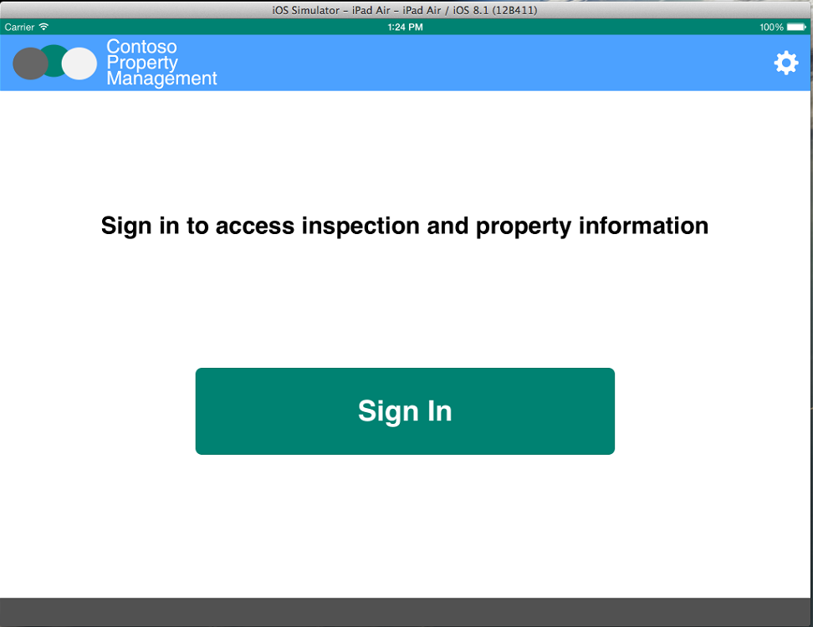
Click Sign In

Slide 19
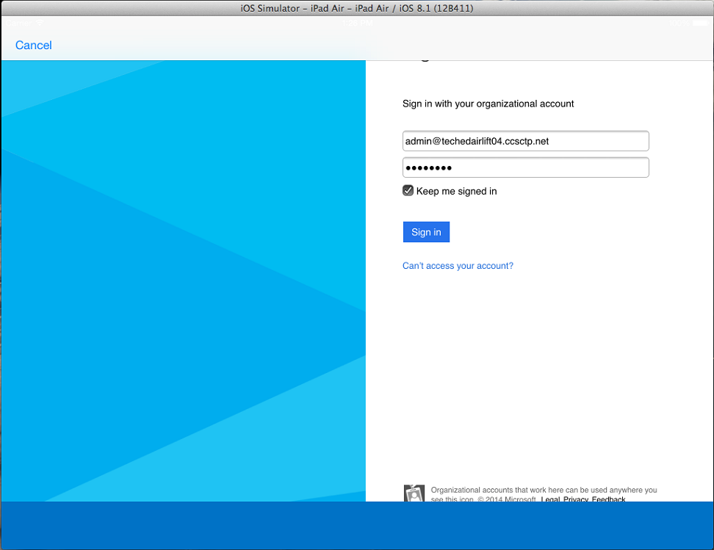
Enter Credentials Click Keep Me Signed In Click Sign In

Slide 20
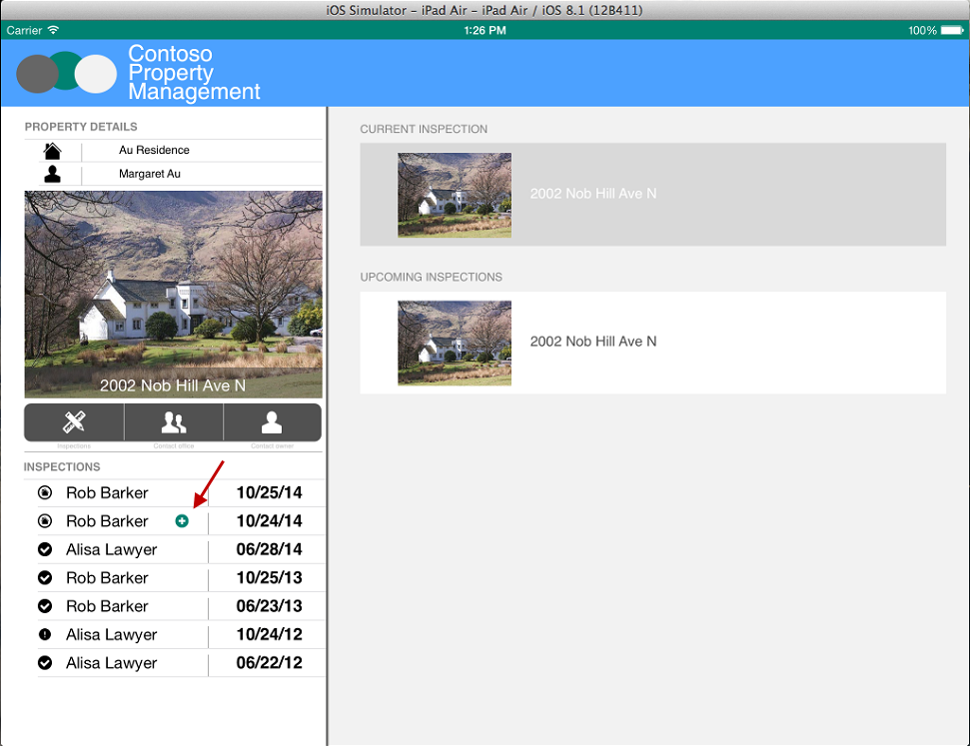
Click Inspection With Plus Icon

Slide 21
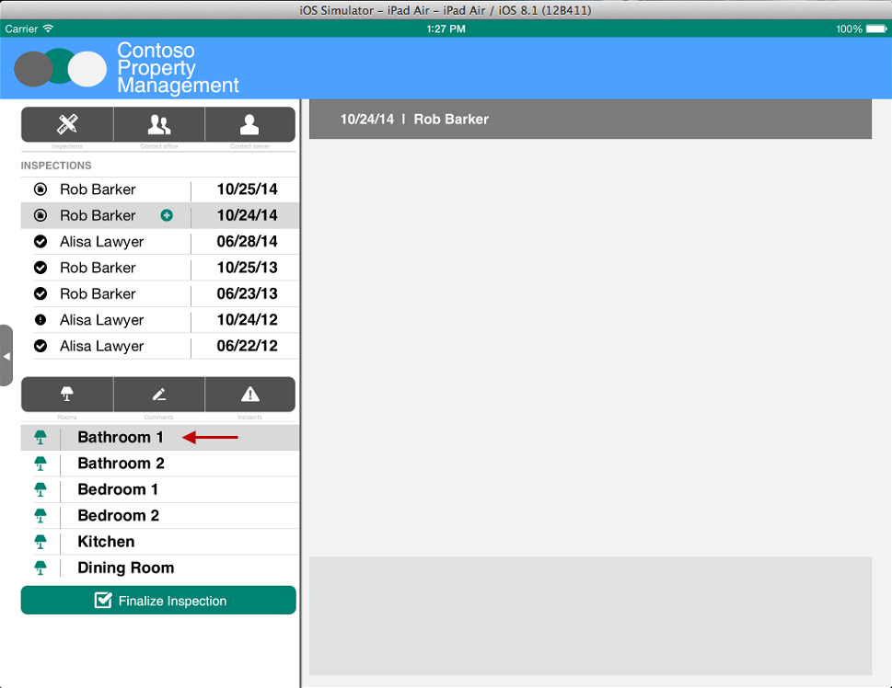
Select Bathroom 1

Slide 22
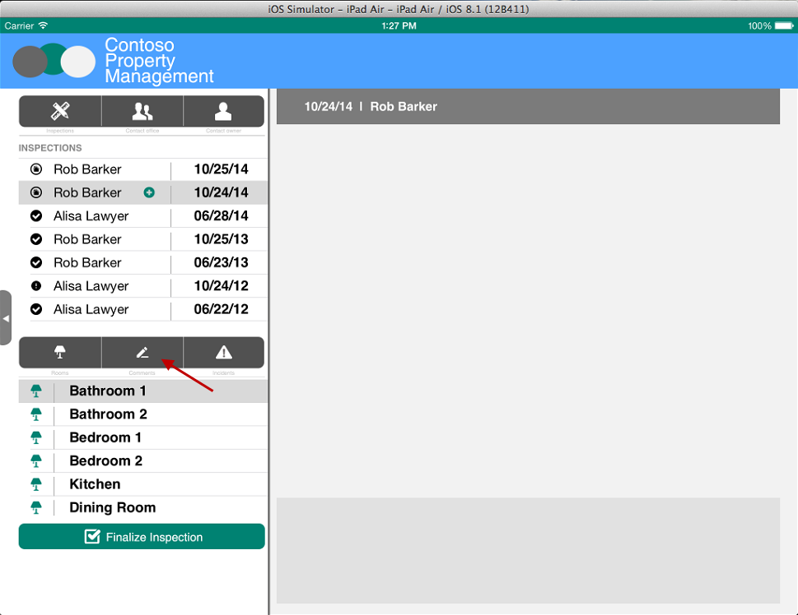
Click Comments

Slide 23
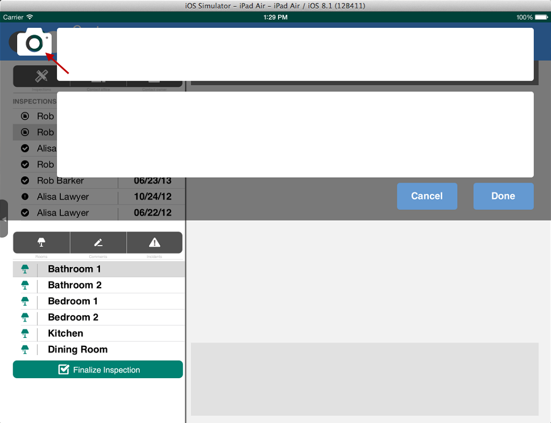
Click Camera

Slide 24
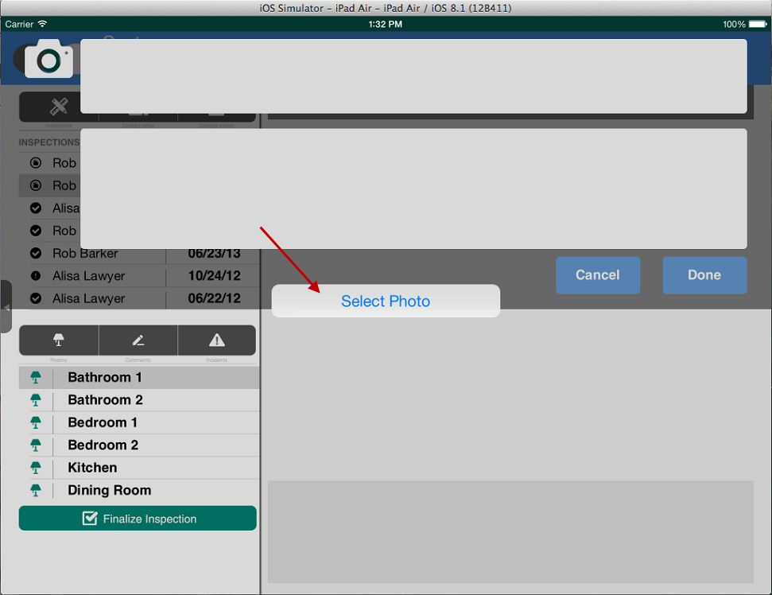
Select Photo On Simulator Or Take Picture On iPad

Slide 25
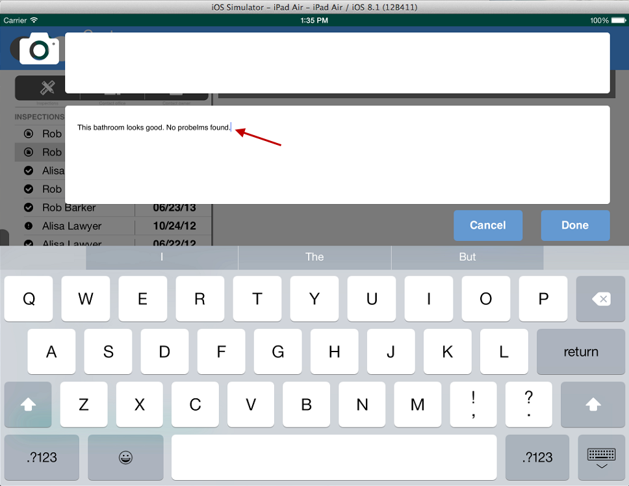
Enter Comments

Slide 26
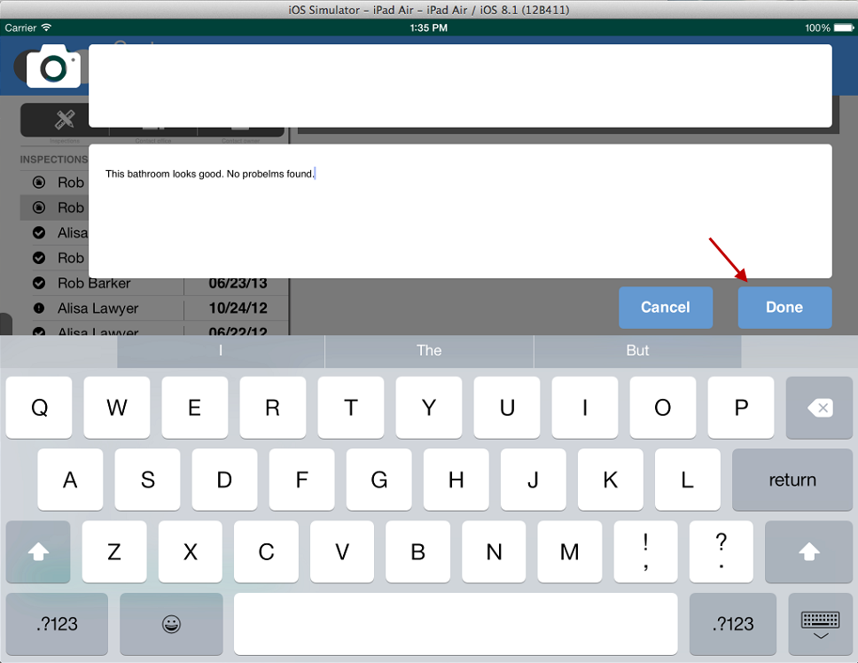
Click Done

Slide 27
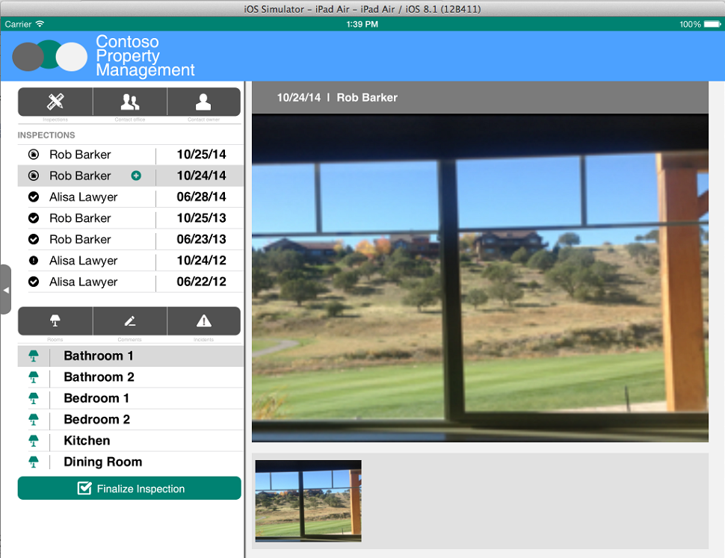
Picture is Uploaded

Slide 28
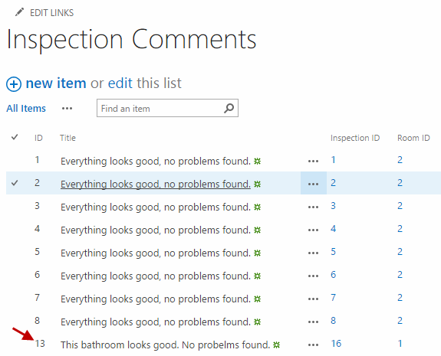
Inspection Comment is created in Inspection Comments List

Slide 29
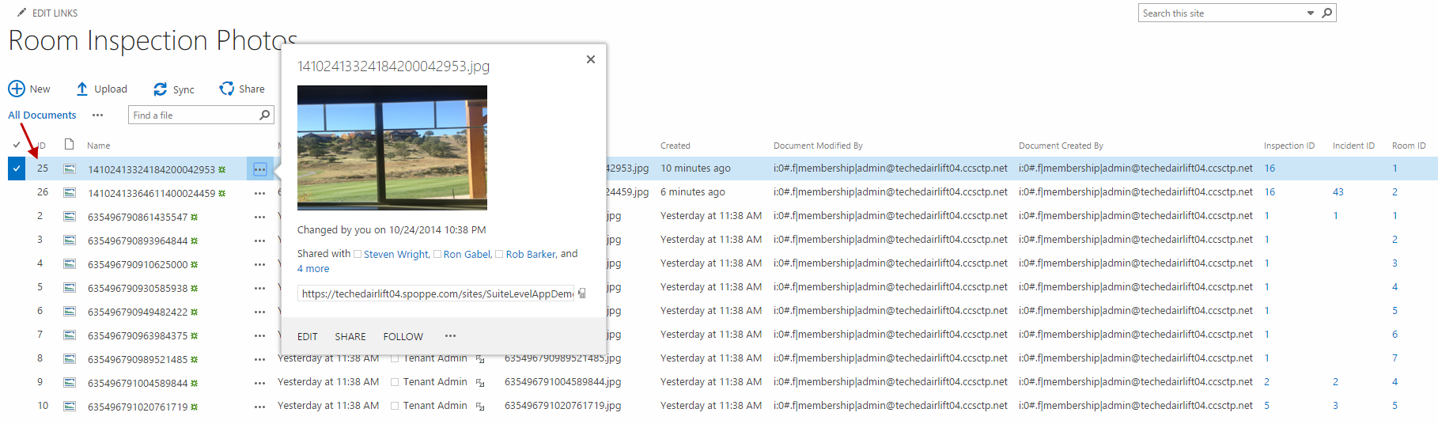
Photo is added to Room Inspection Photos Library

Slide 30
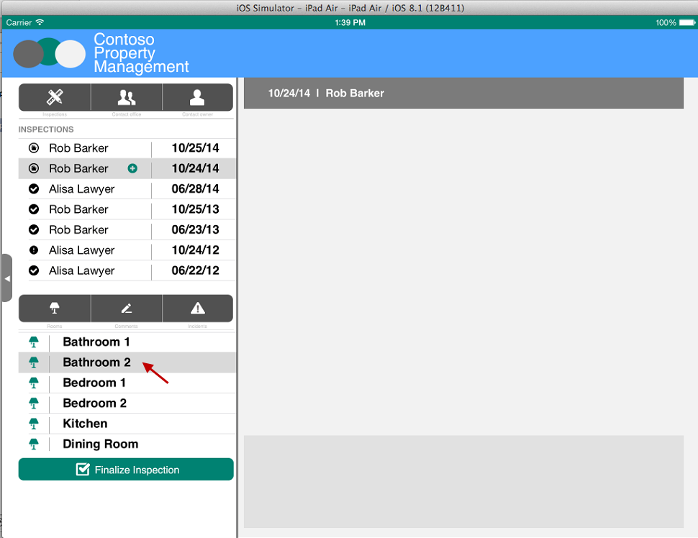
Select Bathroom 2

Slide 31

Click Incidents

Slide 32
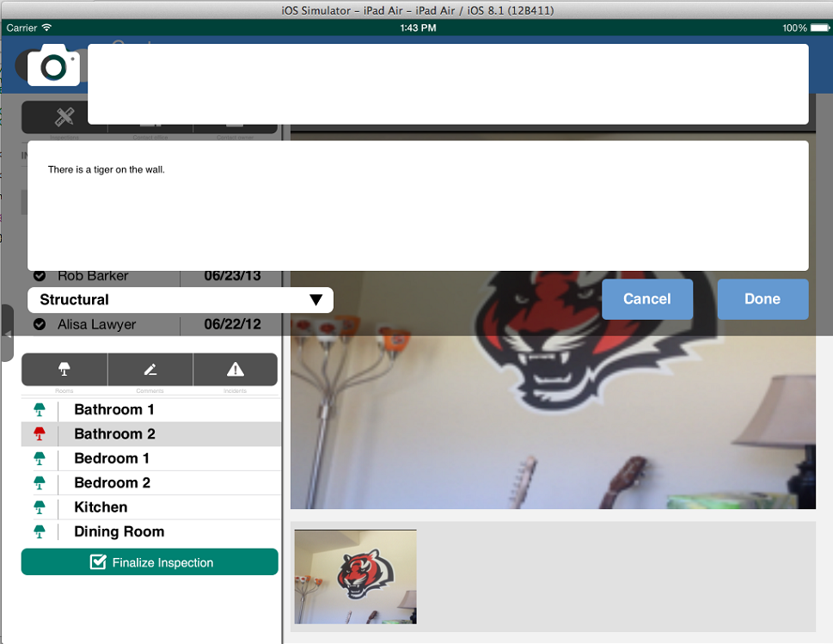
Just like you did in the Inspection Comments popup, take a picture and enter comments. Then, select an Incident Type and click Done.

Slide 33
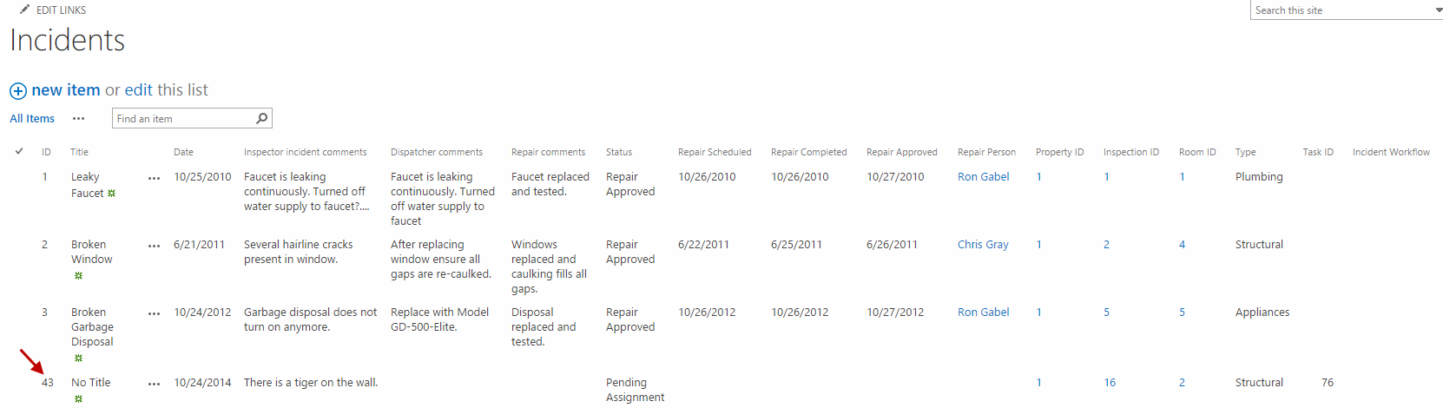
Incident is created in Incidents List

Slide 34
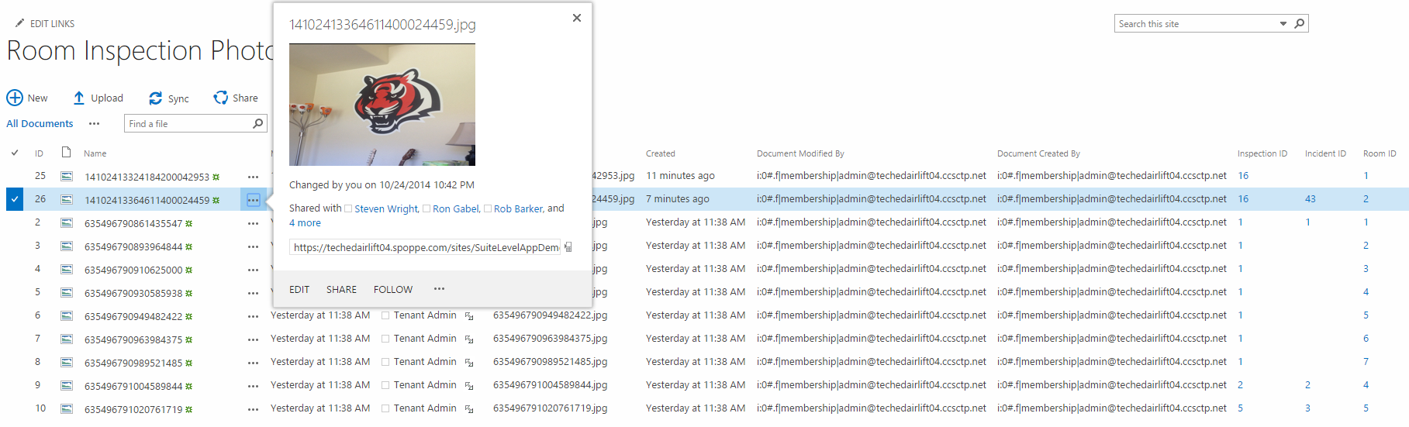
Photo is added to Room Inspection Photos Library

Slide 35
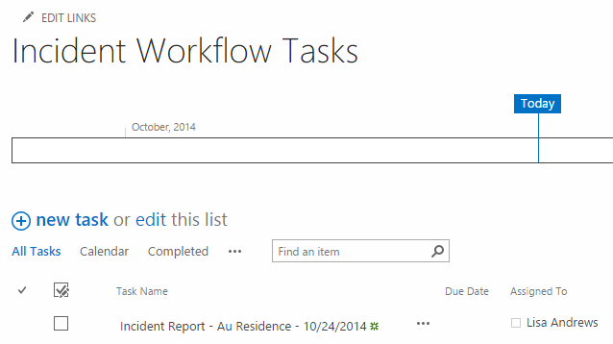
Workflow Task is created for Dispatcher

Slide 36
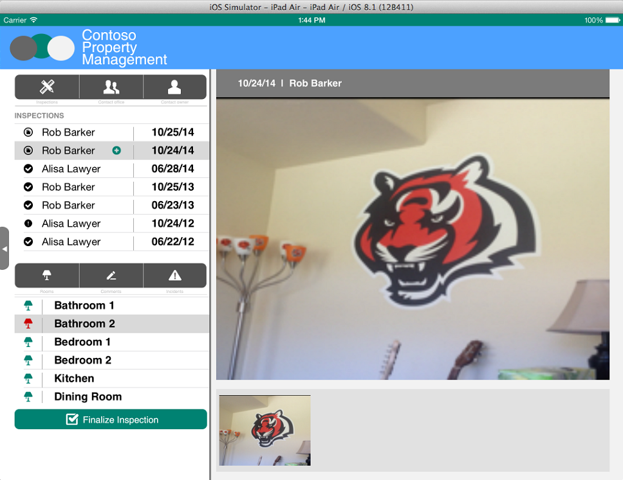
Click Finalize Inspection

Slide 37
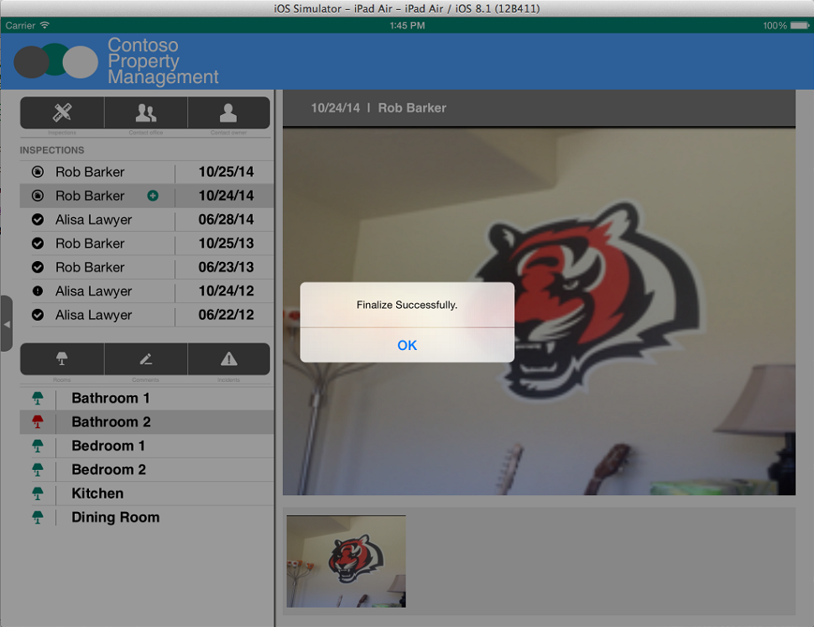
Get Confirmation

Slide 38
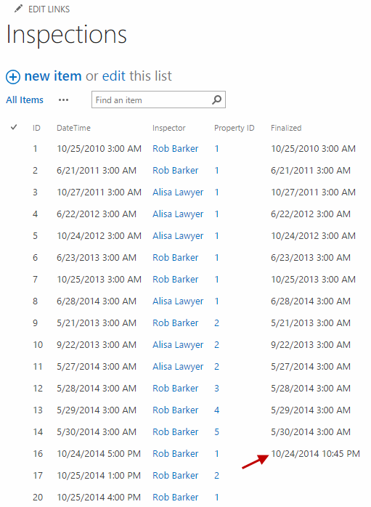
Inspection is updated with Finalized Date

Slide 39
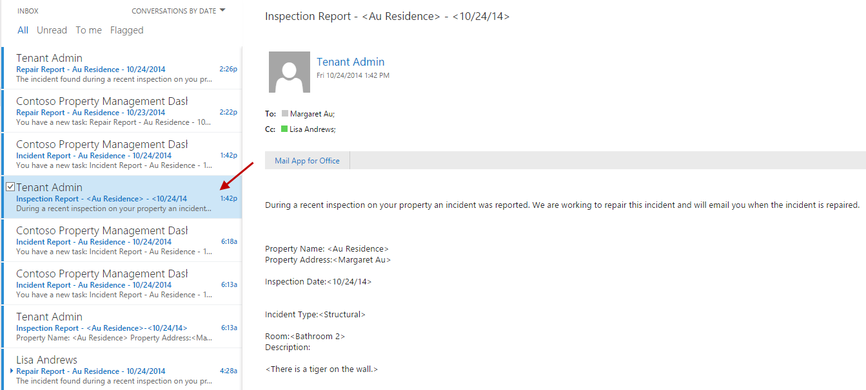
Inspection report email is sent to property owner and dispatcher Log in with Dispatcher account to see the email

Slide 40
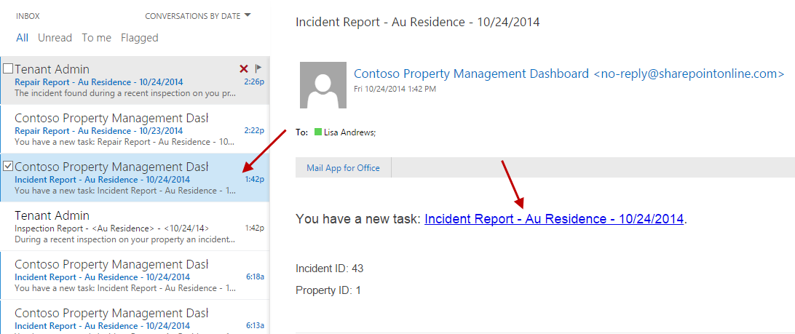
Email with Task to Assign Repair Person is sent to dispatcher Log in with Dispatcher account to see the email

Slide 41
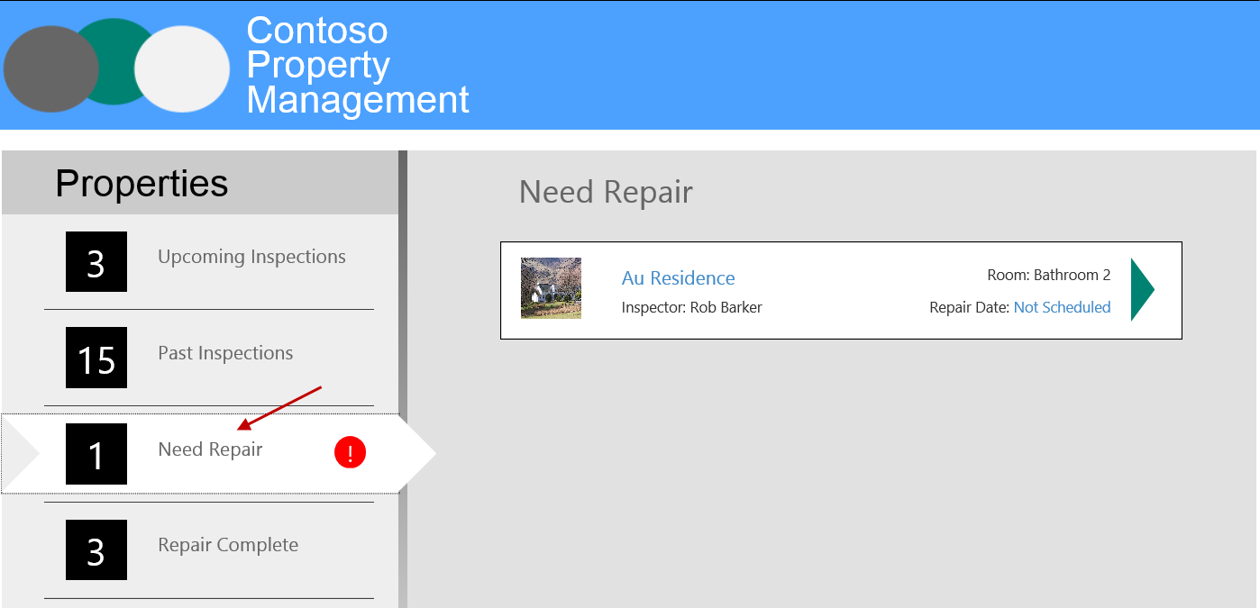
Open Property Management My App Dashboard, click Need Repair

Slide 42
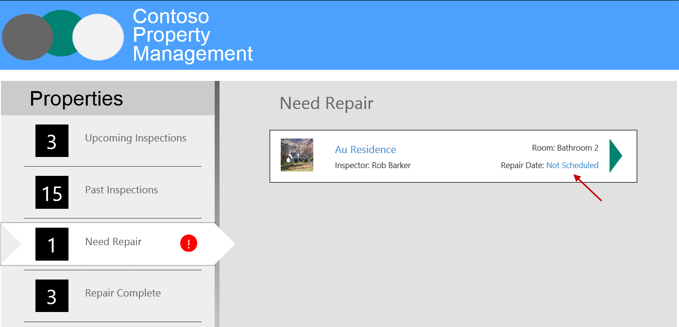
Click Not Scheduled

Slide 43
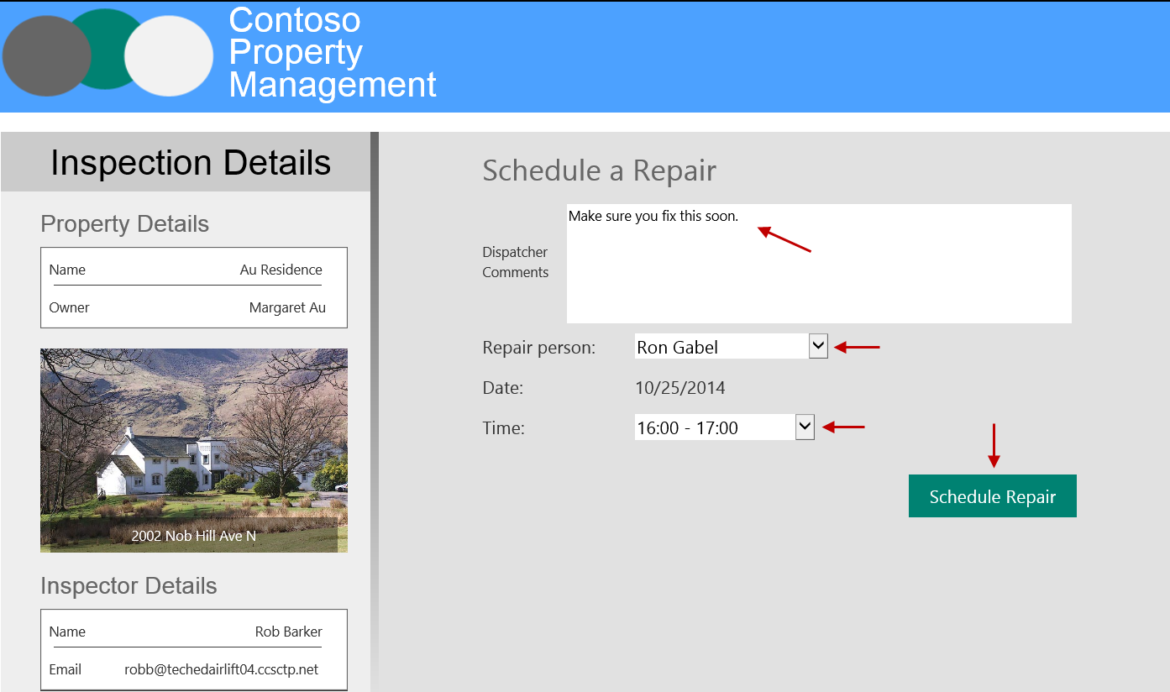
Enter comments, select Ron Gabel, select Time, click Schedule Repair

Slide 44
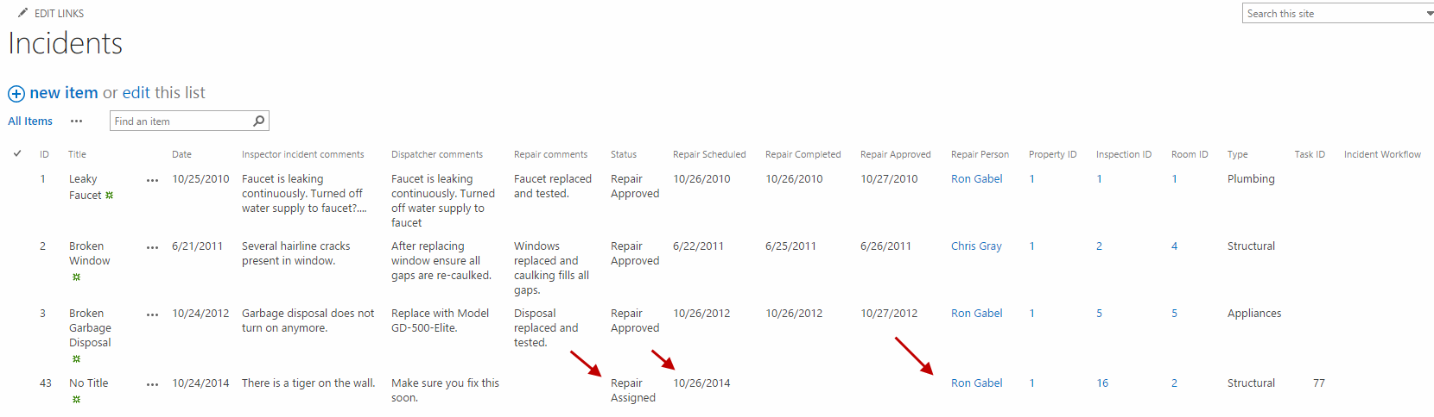
Incident is updated to reflect Status, Repair Scheduled Date, and Repair Person assigned

Slide 45
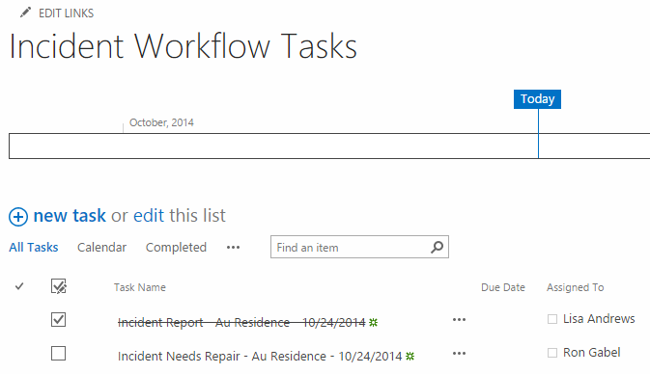
Workflow Task for Dispatcher is completed Workflow Task for Repair Person is created

Slide 46
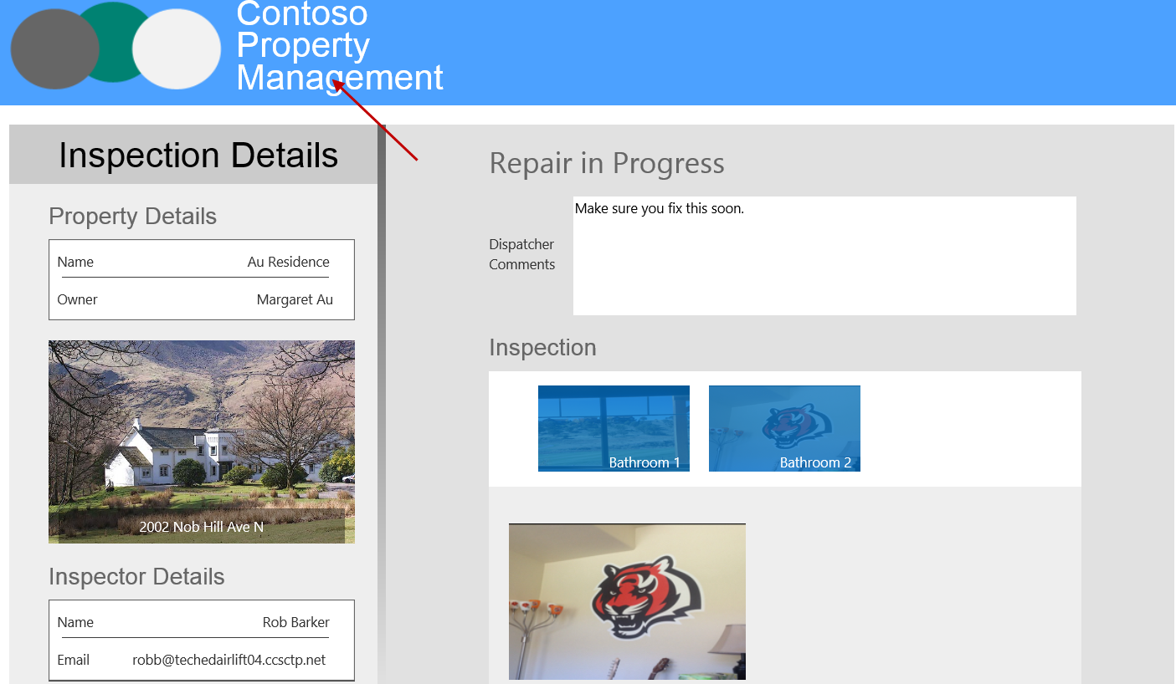
Click the header

Slide 47
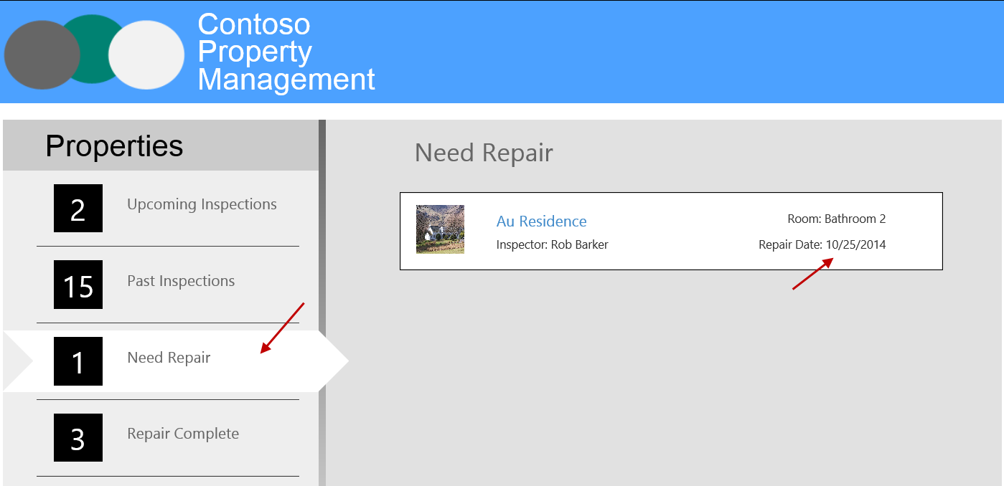
Click Need Repair and mention the repair is scheduled

Slide 48
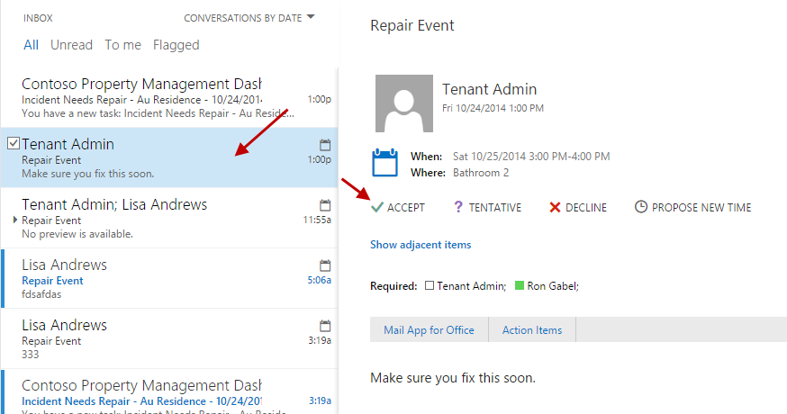
View Calendar Invite Sent To Ron Gabel And Accept Log in with Repair Person account to see the email

Slide 49
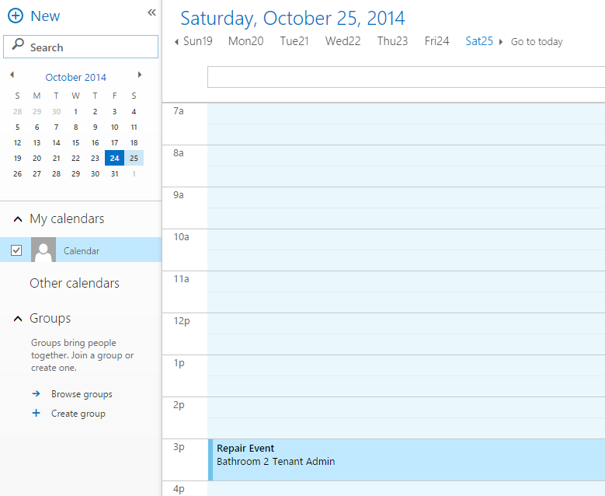
View Calendar Event

Slide 50
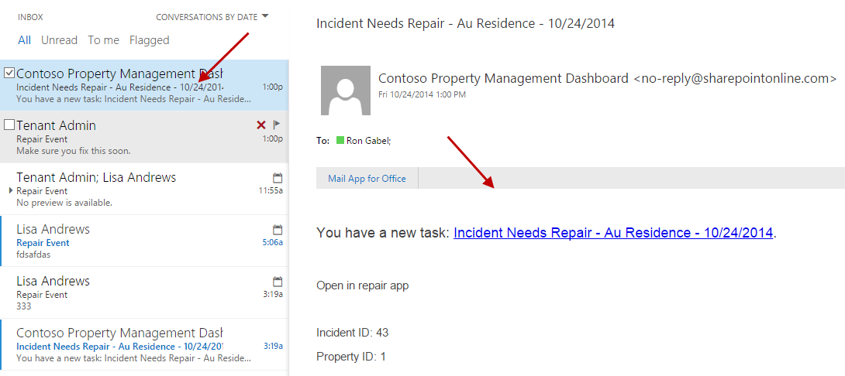
View Repair Task Email sent to Ron Gabel Log in with Repair Person account to see the email

Slide 51
Click Open in Repair App

Slide 52
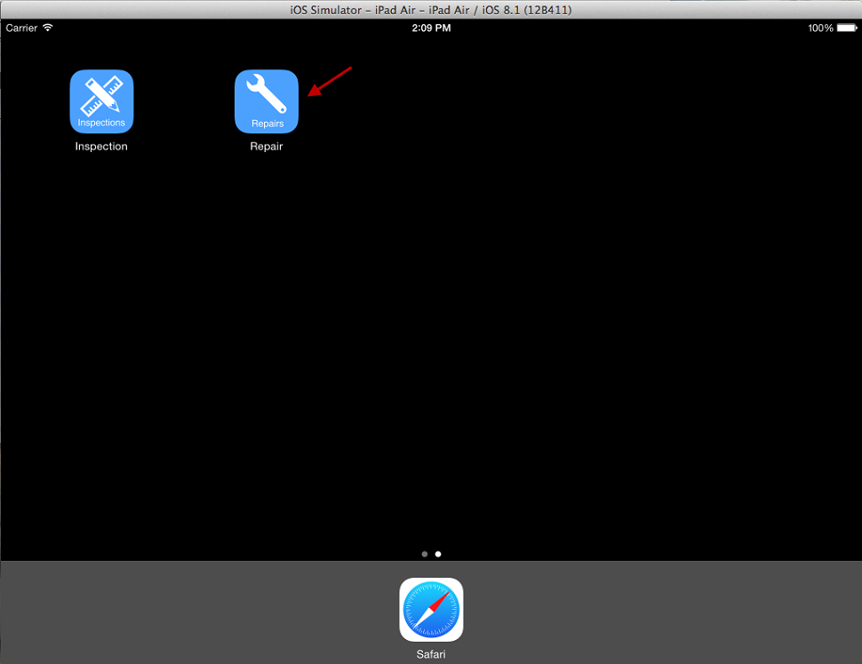
Open Repair App

Slide 53
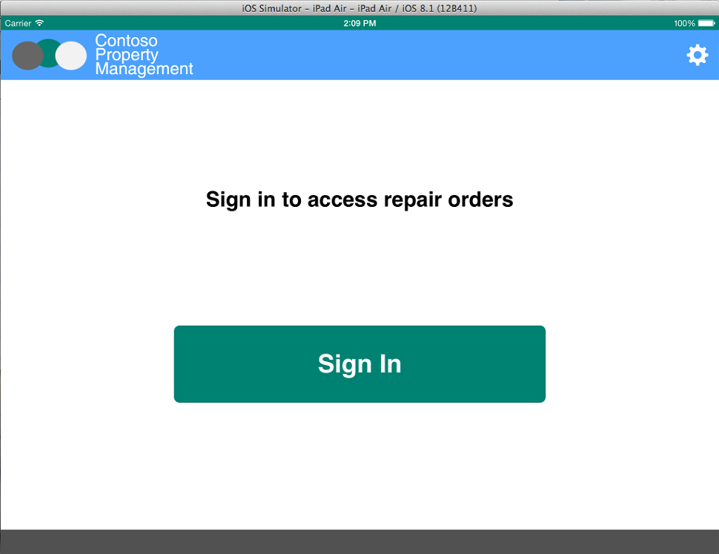
Click Sign In

Slide 54
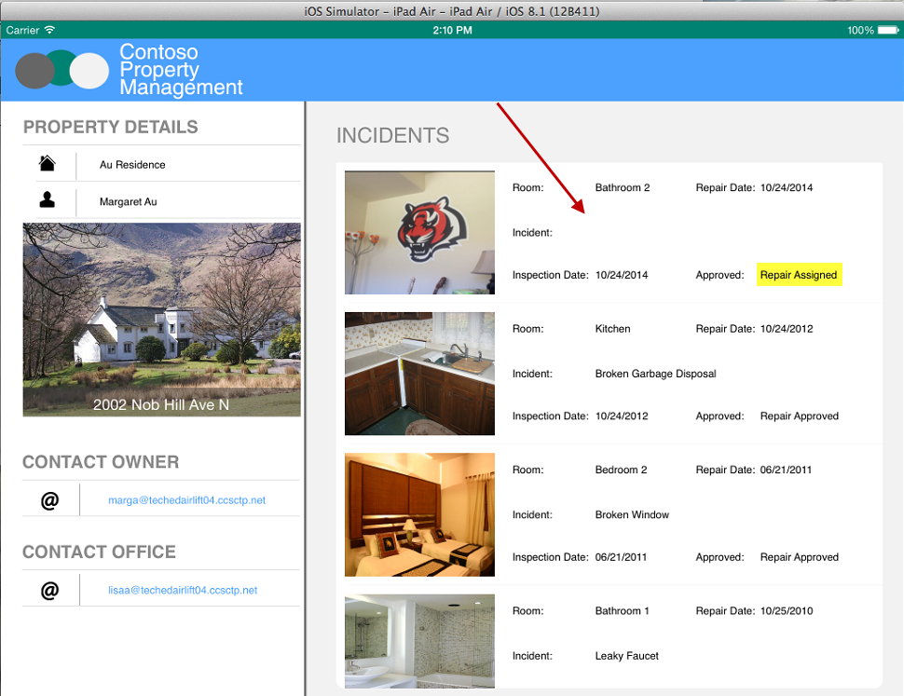
Click the Repair Incident assigned by the Dispatcher

Slide 55
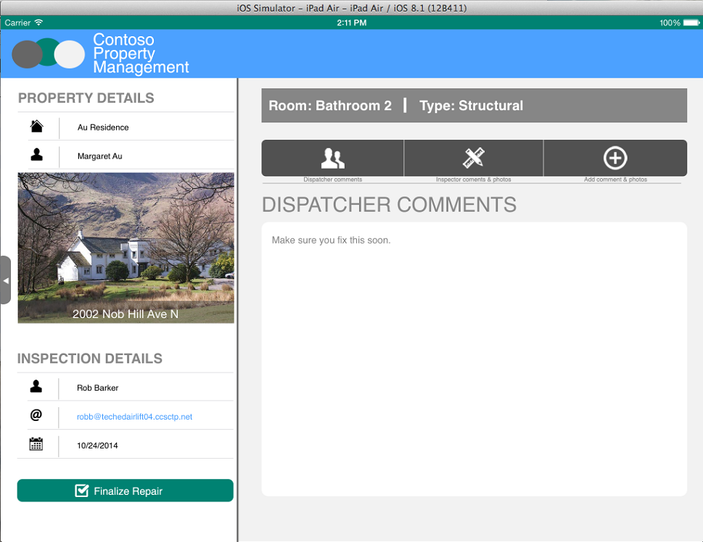
Look at Dispatcher Comments

Slide 56

Click Inspector Comments and Photos

Slide 57
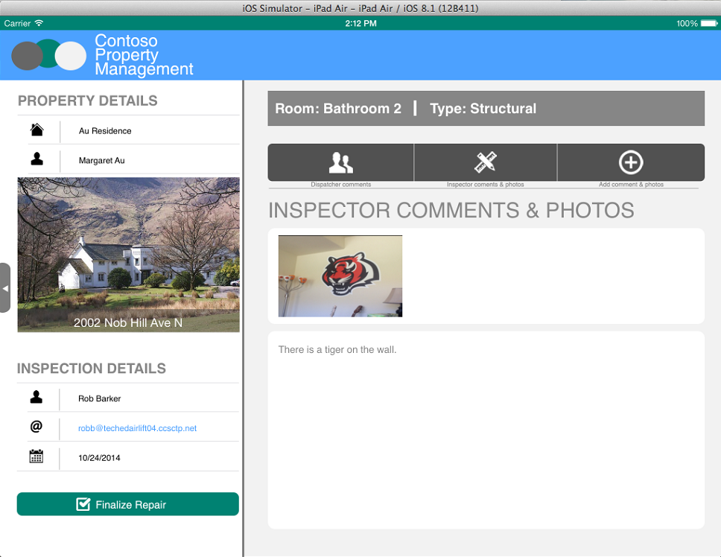
Look at Inspector Comments

Slide 58
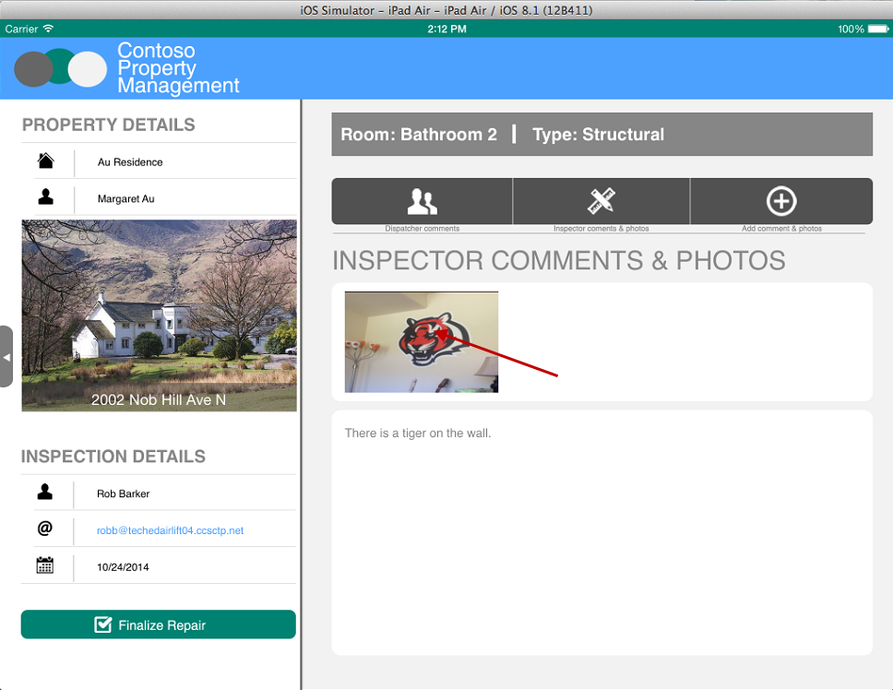
Click Photo

Slide 59

View Photo Full Size, Click X to Close

Slide 60

Click Add Comment And Photos

Slide 61

Click Finalize Repair

Slide 62

Incident list updated with Repair comments, Status, and Repair Completed date

Slide 63

Photo is added to Repair Photos Library

Slide 64

Workflow Task for Repair Person is completed Workflow Task for Dispatcher is created

Slide 65

Email is sent to Dispatcher to approve repair Log in with Dispatcher account to see the email

Slide 66

Refresh Property Management My App and click Repair Complete

Slide 67

Click Not Approved

Slide 68

Browse all data and images and click Approve Repair

Slide 69

Refresh Property Management My App and click Repair Complete to see completed status

Slide 70

Workflow Task for Dispatcher is completed

Slide 71

Incident is updated with Repair Approved Status and Date

Slide 72

Workflow History is updated to close workflow

Slide 73

Repair Report Email is sent to Dispatcher and Property Owner Log in with Dispatcher account to see the email

